Slide 1
Lesson objective
Title: Topic review
Aim:
Create a transformation poster that helps revise the entire topic so far.
Plan:
Start poster
Test Wednesday
Revision Friday and Tuesday.

Slide 2
Transformation poster
Create a revision poster.
Try to use everything somewhere in your poster (BE CREATIVE)
Check list:
Translations
Reflections
Rotations
3 ways we draw shapes (Oblique, Orthogonal and isometric)
Hints, tricks and tips
Coordinates after a transformation

Slide 3
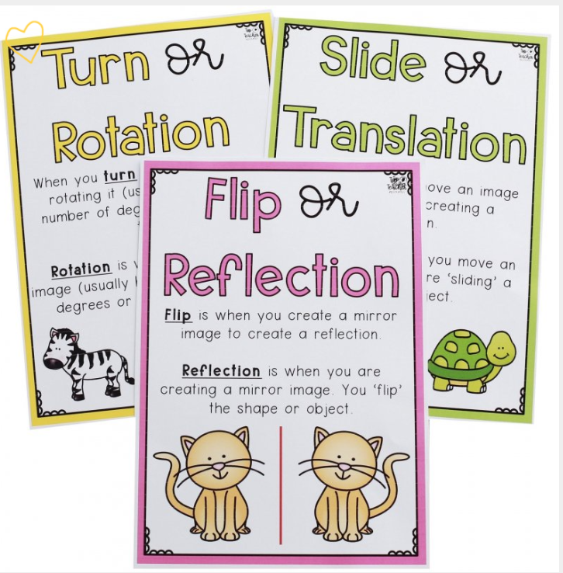

Slide 4
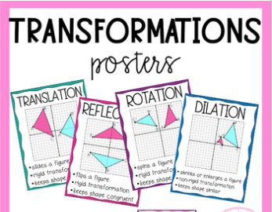

Slide 5
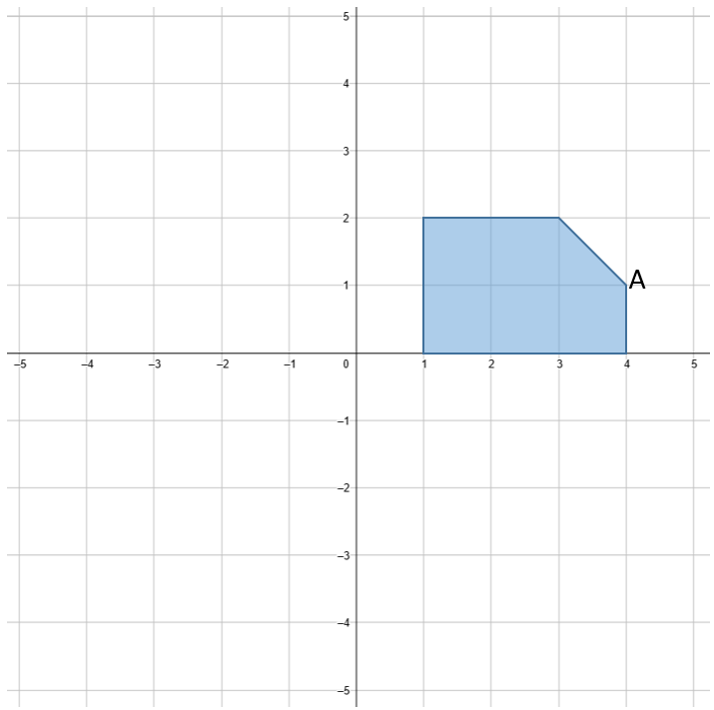
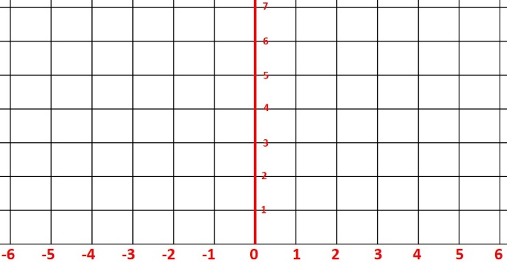
Start
TRANSLATION
Reflection
Rotation
B
A
Translate the shape R5, U1
Translation is …….
Reflection is …….
Rotation is …….
Isometric
Oblique
Orthogonal

